Slide 1

BENV0091 Lecture 2: Programming & Visualisation
Hector Camm and Cato Davies

Slide 2
Lecture Overview
Part 1: Programming
Functions
If-Else
Iteration
Part 2: Introduction to Visualisation with ggplot2

Slide 3
Part 1: Programming

Slide 4
Setting up
Task: open RStudio and create a new project called lecture2, making it a subdirectory of BENV0091 from last week
Open a new R Notebook or Markdown file and save it as programming.Rmd in your lecture2 directory

Slide 5
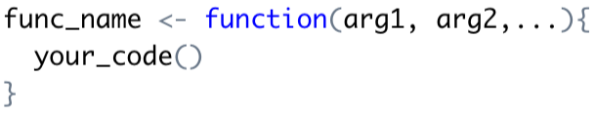
Functions
We have been introduced to several functions such as print(), mutate(), mean() etc.
Functions can be useful to avoid repetition
Functions also improve readability
We can write our own functions in R (using the syntax on the right)
Task: write a function addition(x, y) which returns the sum of two arguments
Test your function with different inputs, making sure it gives the correct answers
If you want your function to output something, use return(output)
If you do not specify return(…), the function returns NULL

Slide 6
Functions: Exercises
Write a function to calculate the interquartile range of a vector
Write the following functions for the mpg dataframe:
Calculate the average hwy MPG for a specified manufacturer
Return the highest cty MPG for a specified class and drv
Calculate the correlation between cty MPG and displ for a specified class
Create a vector with c(x, y,…)
Use quantile(vector, x) to find the x (as decimal) quantile of a numeric vector
The mpg dataframe is built into ggplot: it is already assigned to an object named mpg
Use cor(x, y) to calculate the correlation between vectors x and y
Test out your functions with different inputs: make sure they give sensible answers!

Slide 7
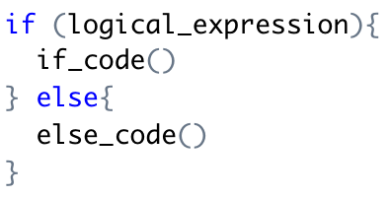
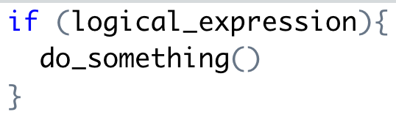
If-Else
Condition
The If-Else statement is an essential building block of programming
It relies on logical expressions that evaluate to TRUE or FALSE (logical variables)
Task: write a function that prints “Even” or “Odd” depending if the input an even/odd number
Task: modify the function to print “Not an integer” if the input is not an integer
Execute If code
Execute Else code
x %% y gives the remainder of x/y

Slide 8
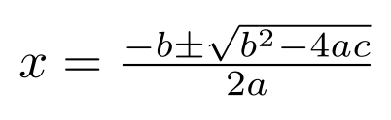
Exercises
Write a function that checks if a letter is a vowel (return TRUE or FALSE)
Using a nested if-else statement, write a function that prints:
”Big and even!” if input is an even number that is greater than 10
“Big and odd!” if input is an odd number that is greater than 10
”Small :(” otherwise
Write a function that finds the roots of a quadratic equation given coefficients a, b, c
Write a function to change a word to lower case and remove vowels
Nested if-else statements: if-else within if-else!
Quadratic formula
Tip: tolower()
Tip: str_remove_all()

Slide 9
Vectorised If-Else
It can be useful to use If-Else to transform data
The ifelse() (base R) and if_else() (dplyr) functions are designed to make it easy to apply If-Else statements to vectors (e.g. in data frames)
Task: add a `engine_category` column to mpg that is “large” for cars with at least a 2L engine displacement (`displ`), and small for all other cars
Use count() to determine the number of cars with large and small engines
if_else(condition, if_result, else_result)

Slide 10
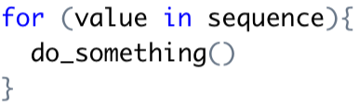
Iteration: For Loops
Often you will want to perform the same operation on multiple inputs:
Reading multiple data frames
Calculating statistics for multiple columns
A for loop is a handy way to iterate over a vector (i.e. a sequence of values)
Task: write a for loop that prints the numbers 1 to 100
Use an if statement to print only multiples of 7
Create a sequence of integers from x to y with x:y

Slide 11
For Loop Exercises
Write a for loop that reads each of the CSV files in the beis_headcount directory
For each year in the beis_headcount directory find out the following:
Total headcount
Headcount of the Committee for Climate Change
Headcount of the UK Space Agency
Department with the largest headcount
Write a for loop to read all of the CSV files and combine them into a single data frame
Try adding a `year` column to each data frame before combining
list.files(directory) creates a vector all files in directory
file.path(x, y) joins strings x and y into a single path
str_extract(x, "[0-9]+") extracts all numbers from x
Tip: bind_rows()

Slide 12
Part 2: Visualisation

Slide 13
Data: Canadian Wind Turbines
We will be using data on Canadian wind turbines (a Tidy Tuesday dataset)
Download from Moodle and add to your lecture2/data directory
Open a new R Notebook and save it as visualisation.Rmd
Read the CSV file and assign it to an object called `turbines`

Slide 14

ggplot2
ggplot2: Elegant Graphics for Data Analysis (book)
We will be using the ggplot2 (tidyverse) package for visualisation in R
gg stands for “grammar of graphics”
ggplot uses layers to iteratively build complex plots
Task: run the code below to create a scatter plot of turbine capacity against rotor diameter
Task: try changing the x and y variables to other columns in the turbine data frame

Slide 15
Anatomy of a Plot
Use the + symbol!
Specify the data
Choose a geom function
Specify the aesthetic mapping

Slide 16
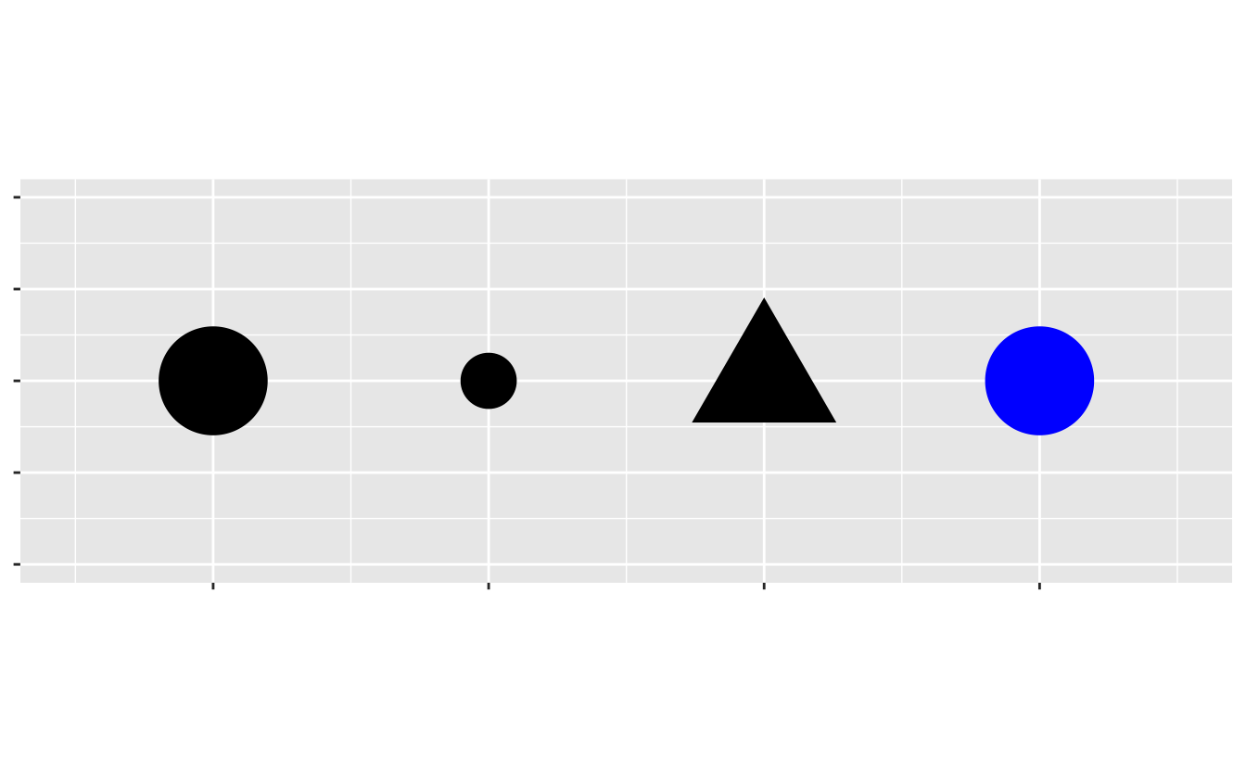
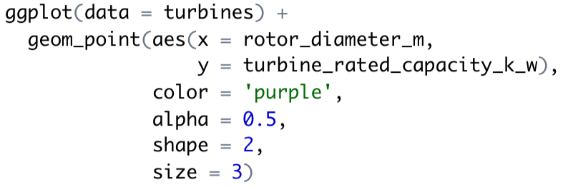
Adding Aesthetics
In addition to x and y aesthetics, we can also specify further aesthetics for points in a scatterplot:
colour
shape
size
alpha
What sort of data (categorical or continuous) is appropriate for each aesthetic?
Task: assign the size aesthetic to hub height
Task: color points by province
Shape, size and color aesthetics
You can also set a fixed aesthetic for all points

Slide 17
Bar Charts
variable | …
A
A
A
B
The geom_bar() and geom_col() plots can be used to create bar charts
`geom_bar()` counts the number of cases at each x position
`geom_col()` leaves the data as it is
The two geom functions on the right will produce the same plots
Task: produce a plot of the number of wind turbines in each province
geom_bar(aes(x = variable))
variable | count
A | 3
B | 1
geom_col(aes(x = variable, y = count))

Slide 18
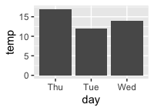
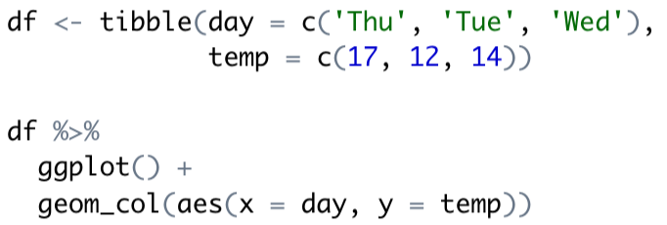
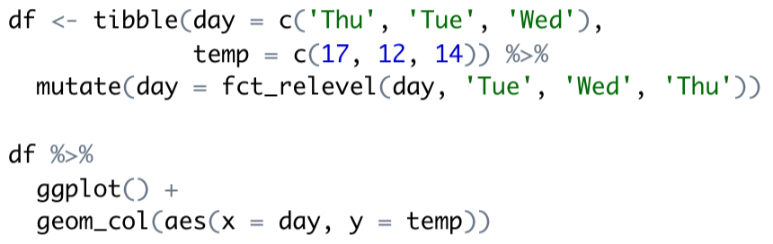
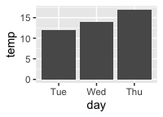
Factors
When dealing with categorical data, ggplot will implicitly convert characters to factors
Factors are used for categorical variables
Factors have levels (categories) whose order you can specify for the purposes of plotting (for instance)
Columns are shown in alphabetical order by default
Factors are reordered manually

Slide 19

Forcats Functions
Useful functions from the forcats package include
fct_lump(): group smaller categories into an ‘Other’ category
fct_infreq(): order a factor by frequency (number of appearances of that category)
fct_reorder(): order a factor by another variable
Type vignette(‘forcats’) for some examples
Task: use fct_reorder() or fct_infreq() to order the bars in the wind turbine bar chart (from decreasing to increasing)
Task: use fct_lump() to reduce the number of provinces to 3 plus an Other category; then plot turbine capacity vs. height, coloured by province

Slide 20
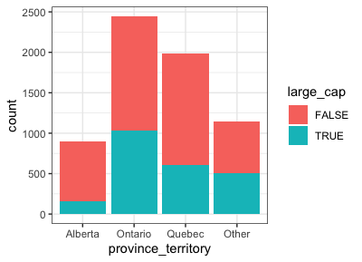
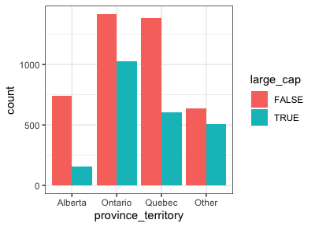
Bar Charts: Fill and Position
position = ‘stack’
For bar charts, a useful aesthetic is `fill` for determining the fill colour of bars
When specifying fill, we can either stack bars on top of one another or place them side by side
position = ‘stack’
position = ‘dodge’
In the right hand plot a column `large_cap` (capacity > 2 MW) has been added to `turbines` using mutate()
position = ‘dodge’

Slide 21
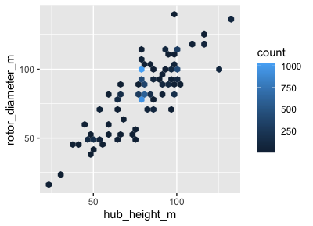
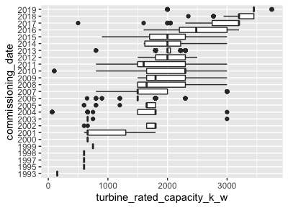
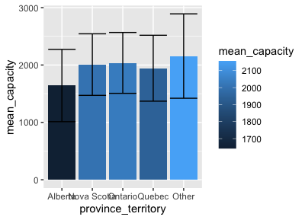
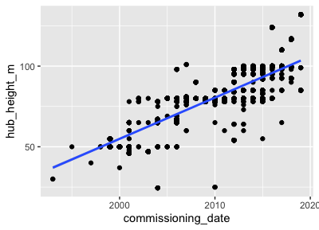
Exercises: Reproduce These Plots!
geom_hex()
geom_boxplot()
geom_point()
geom_smooth()
geom_col()
geom_errorbar()
+/- standard deviation!

Slide 22
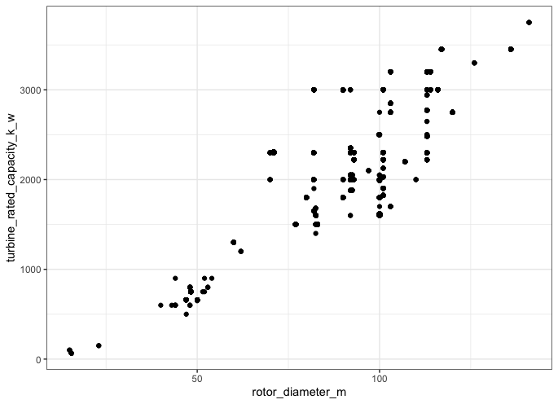
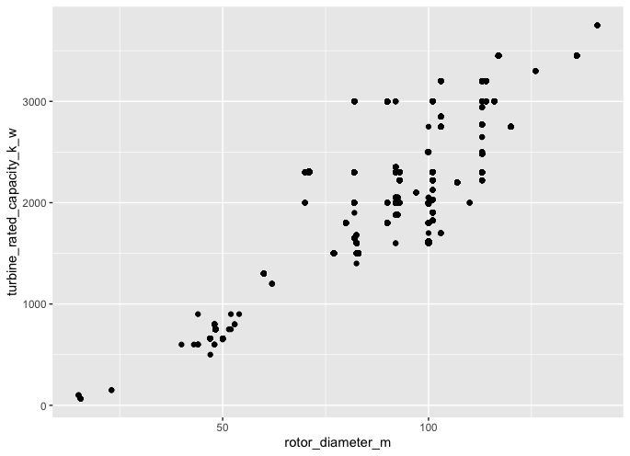
Customising your Plot
theme_bw()
Use labs() to change axis labels and title
Add a theme to change the colors
Change the coordinate system:
coord_flip()
coord_polar()
coord_trans()
Save your plots!
theme_grey()

Slide 23
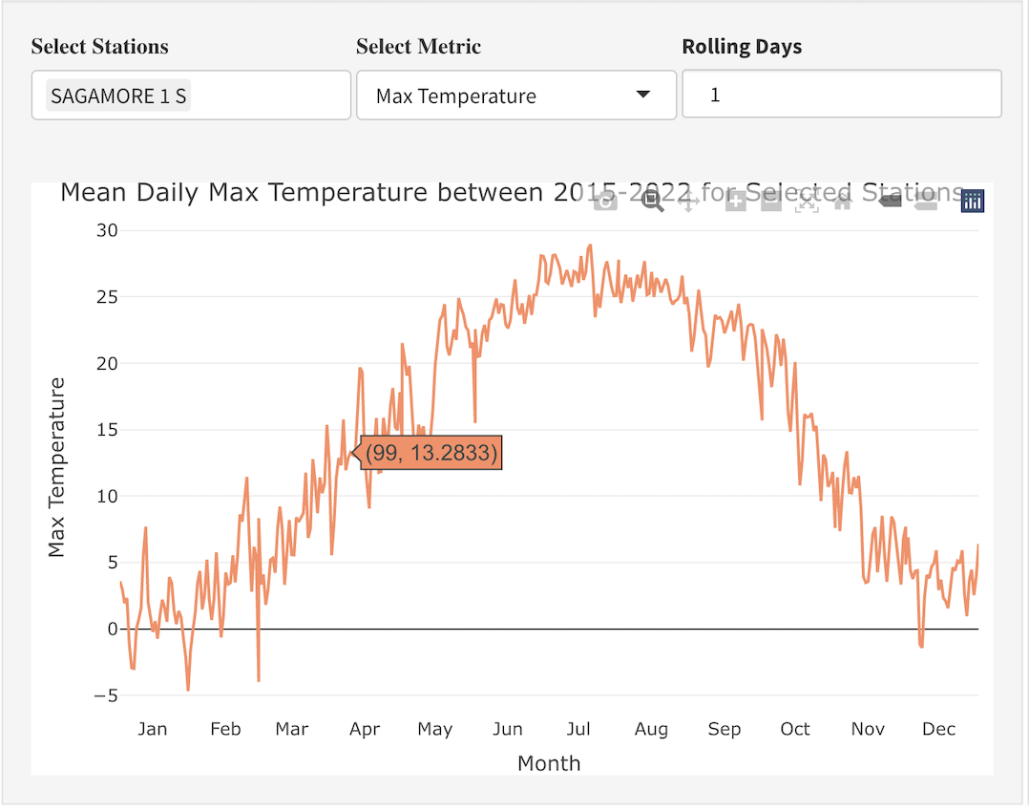
Plotly
Plotly creates interactive plots for HTML scripts and for online content
Plotly can be called by wrapping a ggplot with ggplotly()
Plotly has its own syntax for more complexed plots.
Save your plots!

Slide 24
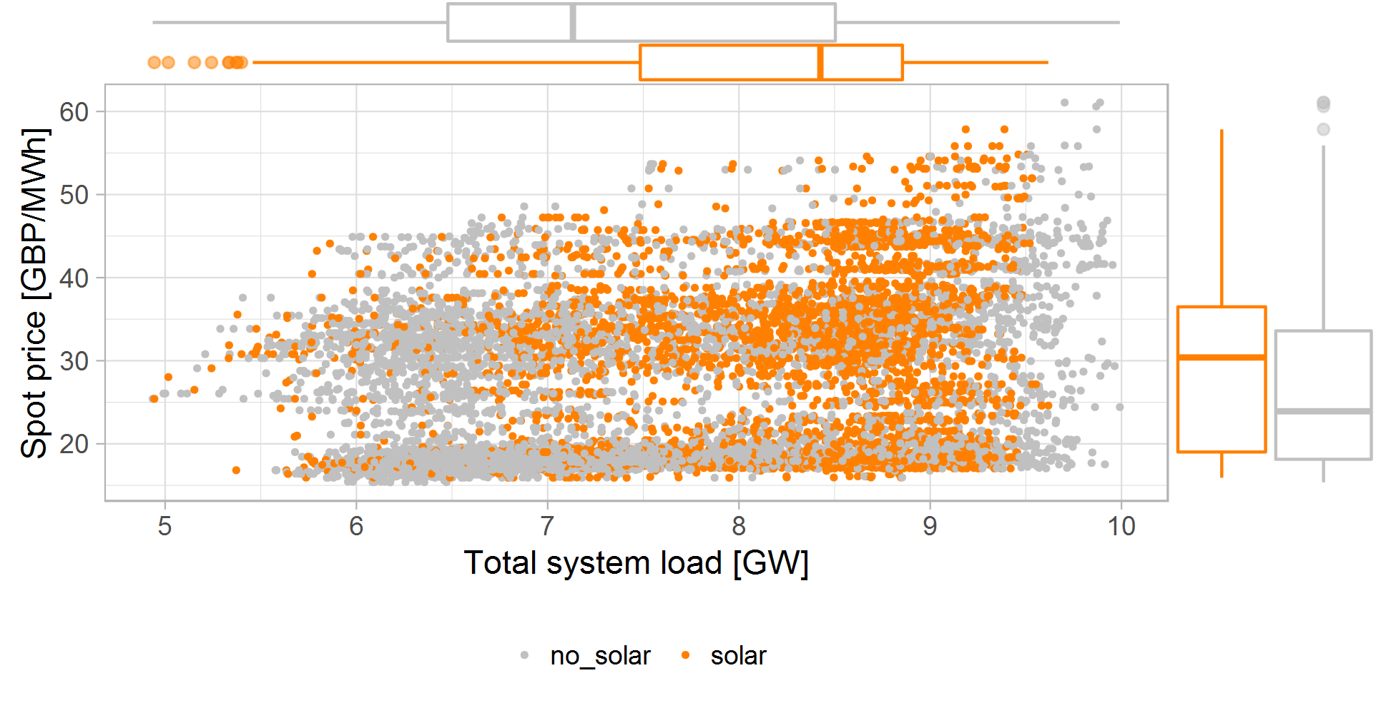
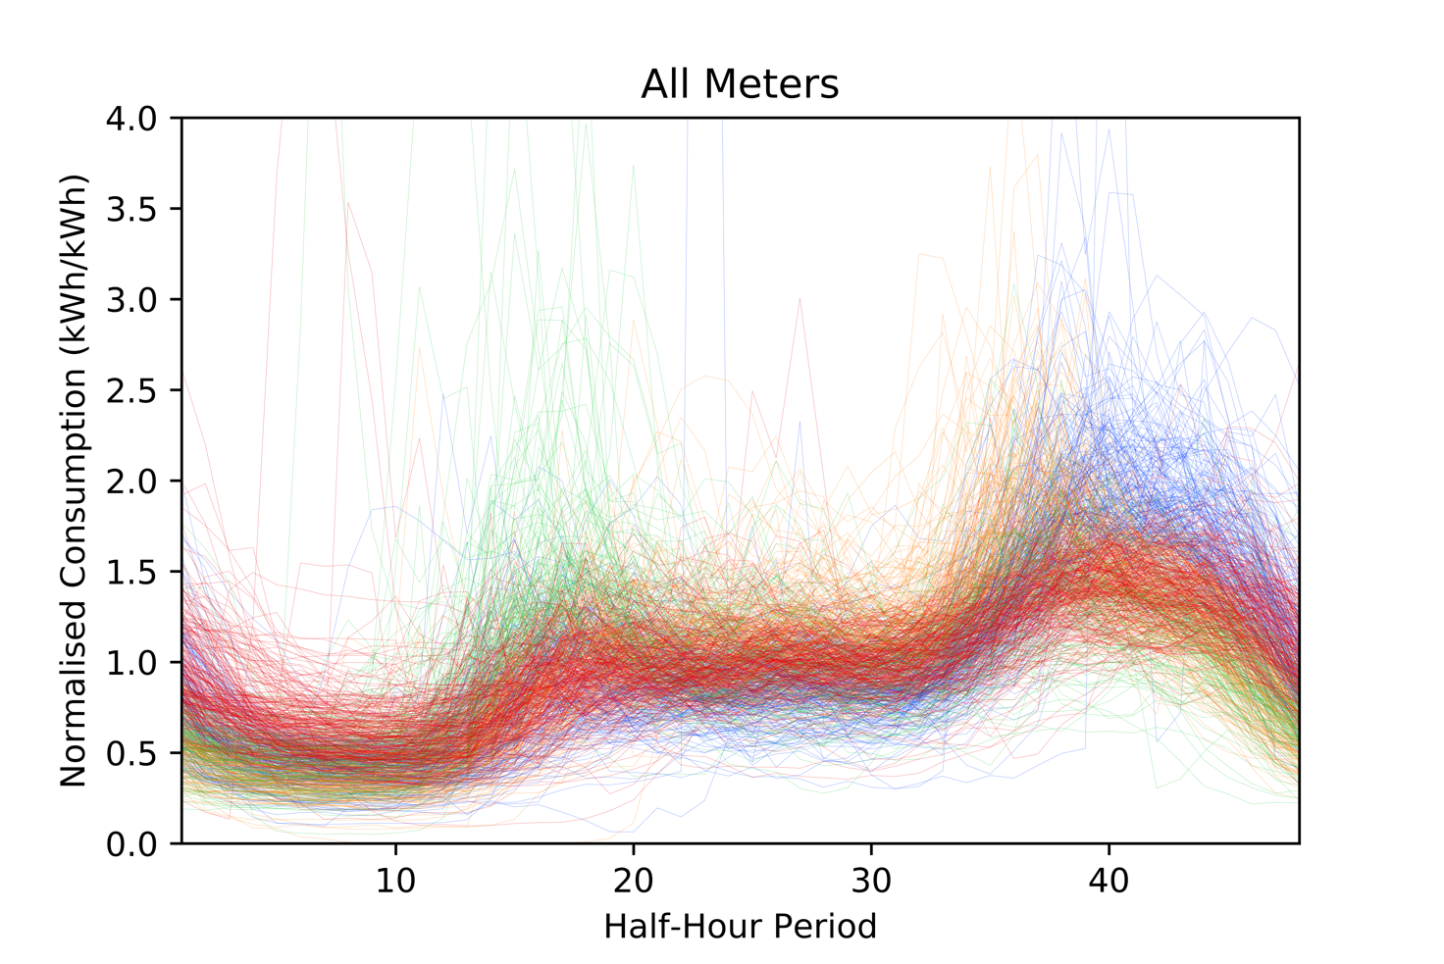
Visualisation Competition!
Produce an energy-related plot using a dataset of your choice
Single figure: no gifs/videos/plotly
No maps!
Visualisations will be judged on:
Is it clear?
Does it help tell a story?
Is it visually appealing?
£100 prize 😱 😱 😱
Email your submissions to Hector with the subject VISUALISATION by 10am on Wednesday 19th October

